Slide 1

BizTalk 2020
The good and the bad

Slide 2

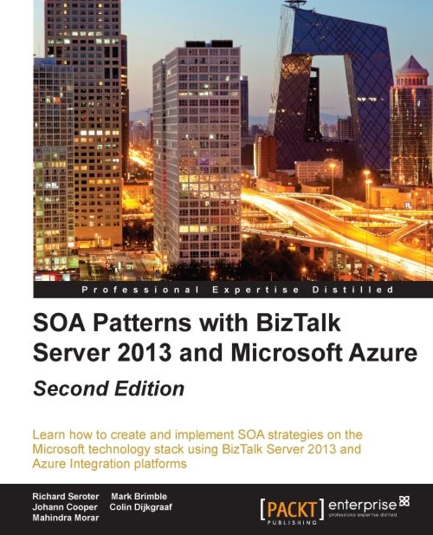
Presenter
Colin Dijkgraaf, Integration Consultant, Datacom New Zealand
https://twitter.com/CDijkgraaf
https://cdijkgraaf.wordpress.com/
https://stackoverflow.com/users/2571021/dijkgraaf
https://social.technet.microsoft.com/profile/colin%20dijkgraaf/

Slide 3
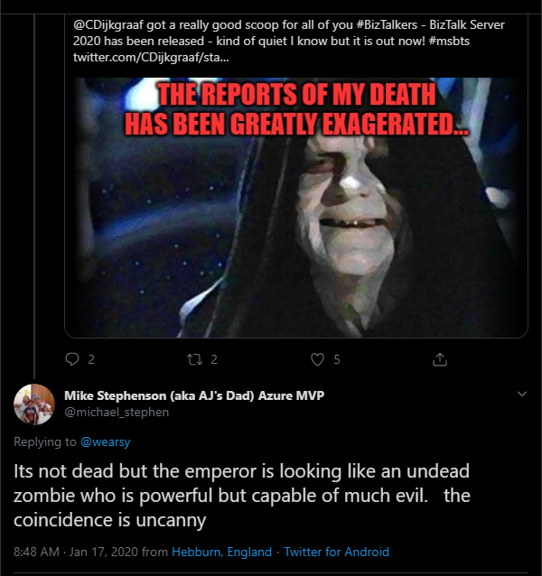

Slide 4


Slide 5
What’s (not) new in BizTalk Server 2020
https://docs.microsoft.com/en-us/biztalk/install-and-config-guides/whats-new-in-biztalk-server-2020#deprecated--removed-list
Program | Status | Replacement
Samples | Removed | Removed from BizTalk Server installation.
POP3 and SMTP adapters | Deprecated | Office 365 adapters
Support for ACS authentication in adapters | Removed | SAS authentication
SOAP adapter | Deprecated | WCF-BasicHttp Adapter
Old SQL adapter | Removed | WCF-SQL Adapter
BPEL support | Deprecated | None
JDE OneWorld adapter | Deprecated | None
OWC redist | Removed | None
BAM Portal | Deprecated | None
WCF-NetTcpRelay adapter | Deprecated | None

Slide 6
What’s new in BizTalk Server 2020
https://docs.microsoft.com/en-us/biztalk/install-and-config-guides/whats-new-in-biztalk-server-2020#new-in-biztalk-server-2020
Feature | Description
Support for newer platforms | BizTalk Server 2020 adds support for the following Microsoft platforms: - Visual Studio 2019 - Windows Server 2019, Windows Server 2016, Windows 10 - SQL Server 2019, SQL Server 2017, SQL Server 2016 SP2 - Office 2019, Office 2016 Hardware and Software Requirements for BizTalk Server 2020

Slide 7
What’s new in BizTalk Server 2020
Feature | Description
Analytics | Operational Data Monitoring and Analytics. Leveraging the power of Azure (Application Insight and Event Hub) for deep data storage and Power BI for reporting and viewing of data. (FP 1 for BizTalk 2016)
Application Lifecycle Management with VSTS | Using Visual Studio Team Services, you can define multi-server deployments of BizTalk Server 2020, and then maintain those systems throughout the application lifecycle. (FP 1 for BizTalk 2016)
Management APIs | Manage your environment remotely using the new REST APIs with full Swagger support. (FP 1 for BizTalk 2016)
Support for Always Encrypted | Use the WCF-SQL adapter to connect to SQL Server secure Always Encrypted columns. (FP 1 for BizTalk 2016)
Advanced Scheduling | New and improved scheduling capabilities in Adapters. (FP 1 for BizTalk 2016)

Slide 8
What’s new in BizTalk Server 2020
Feature | Description
Backup to Azure Blob Storage | When deploying BizTalk Server to Azure VMs, you can backup BizTalk Server databases to Azure blob storage. (FP 2 for 2016)
Adapter for Service Bus v2 | When using the Service Bus Adapter, you can utilize Azure Service Bus Premium for enterprise-scale workloads. (FP 2 for 2016)
Transport Layer Security 1.2 | Securely deploy BizTalk Server using industry-standard TLS 1.2 authentication and encryption. (FP 2 for 2016, later as a CU)
API Management | Publish Orchestration endpoints using Azure API Management, enabling organizations to publish APIs to external, partner and internal developers to unlock the potential of their data and services. (FP 2 for 2016)
Event Hubs Adapter | Using the new Event Hub Adapter, BizTalk Server can send and receive messages with Azure Event Hubs, where BizTalk Server can function as both an event publisher and subscriber, as part of a new Azure cloud-based event-driven application. (FP 2 for 2016)

Slide 9
What’s new in BizTalk Server 2020
Feature | Description
Office 365 Adapters | Leverage the power of BizTalk in newer office automation workflows by integrating with Adapters that allows you to send or receive Office 365 emails, receive or transmit Office 365 calendar events and create Office 365 contacts. (FP 3 for BizTalk 2016)
Group Managed Service Accounts | Extend windows GMSA support to BizTalk operations and services.
Blob Adapter | Send and Receive messages to/from Azure Blob Storage.
Audit Log | Making BizTalk further secure by maintaining audit trails of all management operation.
New Read Only Operator role | Brand new read only operator role to facilitate dev ops model, where access to production stamp is provided without the ability to update anything.

Slide 10
What’s new in BizTalk Server 2020
Feature | Description
XSLT 3.0 | New extensible model for runtime map execution, out of box wiring to work with Saxon XSLT3.0.
Additional updates | Move to new long term supported Microsoft OLEDB Driver for SQL Server.
 | Support for SSO Affiliate applications in SFTP adapter.
 | SQL Availability Group support for BAM DTS Package via SSIS Catalog.
 | Partially disabled receive locations. How to Enable Receive Location Fault Tolerance
 | Throughput improvements for Dynamic Send Ports with Ordered Delivery.

Slide 11



Reference material
Integration Monday presentation by Tom Canter (1 hr 13 min) http://www.integrationusergroup.com/whats-new-in-biztalk-server-2020/
What's New in BizTalk Server 2020 https://docs.microsoft.com/en-us/biztalk/install-and-config-guides/whats-new-in-biztalk-server-2020
Biztalk server 2020 : View Audit log of common management operations with Power BI https://boutalebhicham.wordpress.com/2020/01/27/biztalk-server-2020-view-audit-log-of-common-management-operations-with-power-bi/
BizTalk Server 2020 – Why it’s a game-changer? https://blogs.biztalk360.com/biztalk-server-2020/
BizTalk Server 2020 unwrapped https://blog.vertica.dk/2020/01/19/biztalk-server-2020-unwrapped/
BizTalk 2020 Unboxing - Part 1 http://www.cookingwithdotnet.com/2020/01/biztalk-2020-unboxing-part-1.html
BizTalk 2020 quiet release http://mikaelsand.se/index.php/2020/01/16/biztalk-2020-quiet-release/

